Slide 1
LIBRARY MANAGEMENT SYSTEM
Group By
Vilas Venugopal
Dinesh Varma
Manjunath Ravi
Sanjay Srikanth
Raghavendra Havaldar

Slide 2
Contents
Problem Statement
Short Description
Design
Technology Used
Result

Slide 3
PROBLEM STATEMENT
The library management system is a software system that issues books and magazines to registered students only. The student has to login after getting registered to the system.
The Scope of the application is wide and can be used with any education institute and also can be used in offices with the necessary modifications done.

Slide 4
SHORT DESCRIPTION
A college library management is a project that manages and stores information electronically according to students needs. The system helps both students and library manager to keep a constant track of all the students information available in the library. It allows both the admin and the student to search for the students information.

Slide 5
DESIGN
Run
Fail
Login
Index
Login failed
success
Fail
Logout
Members
Home
Category
Books

Slide 6
TECHNOLOGIES USED
Java Script
HTML
CSS
My SQL
Java

Slide 7
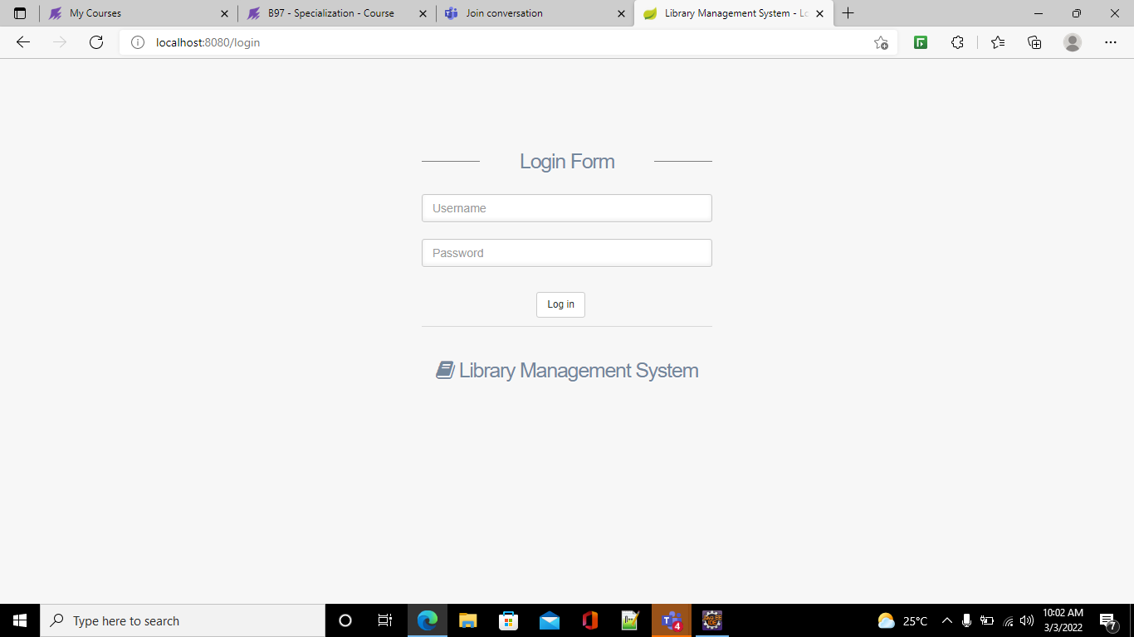
Result

Slide 8
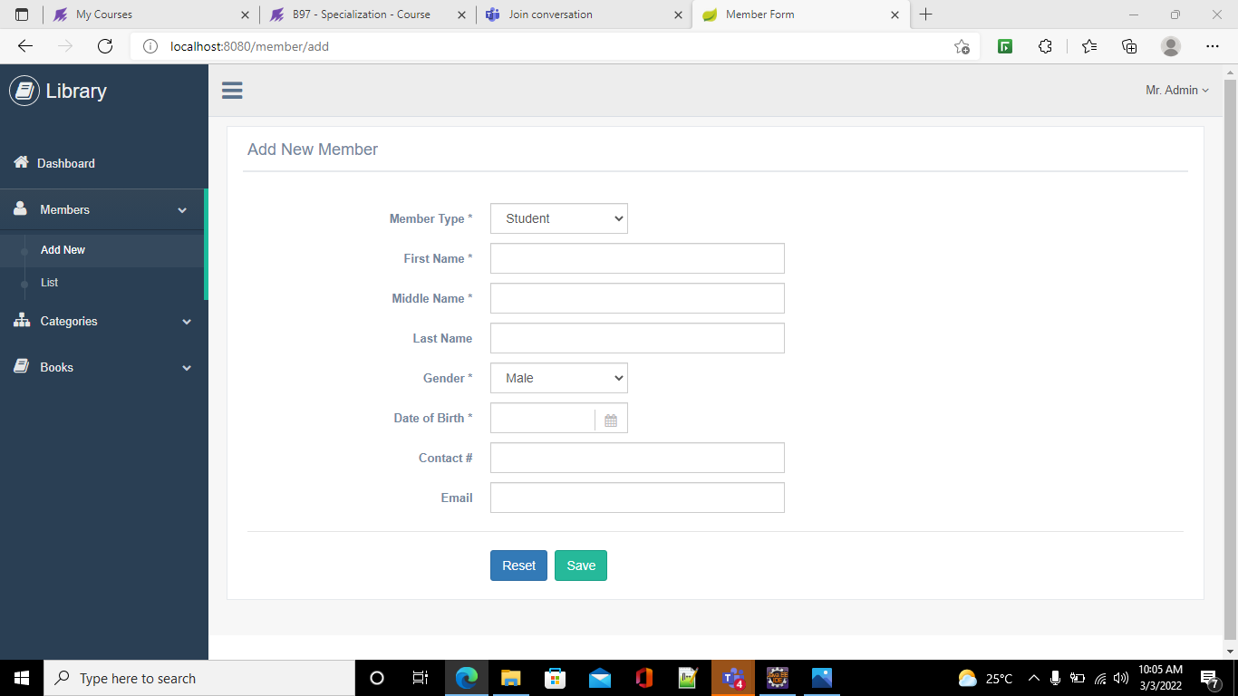
result

Slide 9
THANK YOU

